Slide 1

CS401 Modern Programming Practices (MPP) Professor Paul Corazza
MAHARISHI UNIVERSITY of MANAGEMENT
Engaging the Managing Intelligence of Nature
Computer Science Department

Slide 2
© 2015 Maharishi University of Management, Fairfield, Iowa
All rights reserved. No part of this slide presentation may be reproduced or utilized in any form or by any means, electronic or mechanical, including photocopying or recording, or by any information storage and retrieval system, without permission in writing from Maharishi University of Management.

Slide 3
Lecture 5: Inheritance and Abstractions
Engaging Abstract Levels to Enrich Life

Slide 4
Wholeness of the Lesson
Both abstract classes and interfaces can be used in conjunction with polymorphism, but interfaces provide even more flexibility. Both make possible a variety of implementations or expressions of fundamental themes, the most extreme example of these being the fact that all Java classes inherit from Object. Likewise in the universe, objects form hierarchies of wholeness which express the unmanifest field of pure creative intelligence into all the specific structures of existence and intelligence.

Slide 5
Overview of Topics
Review of inheritance and its implementation in Java
Inheritance and polymorphism
Using abstract classes with polymorphism
Interfaces in Java and using them with polymorphism
Best practices concerning interfaces and some applications

Slide 6
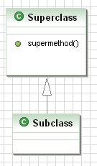
Review of Inheritance
class Superclass {
protected void supermethod() {
int x = 0;
}
}
class Subclass {
}
class Main {
public static void main(String[] args) {
Superclass sub = new Subclass();
//subclass has access to data and
// methods of superclass
sub.supermethod();
}
}

Slide 7
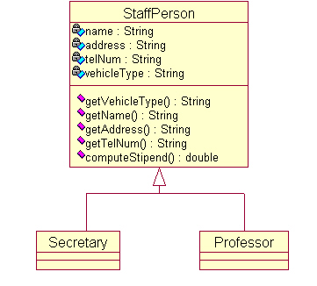
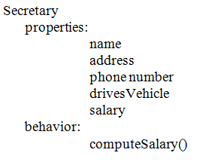
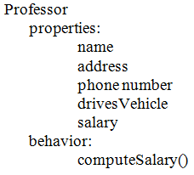
Inheritance Arises . . .
As a way to generalize data and behavior of related classes
See demos in lesson5.lecture.polymorphism1, lesson5.lecture.polymorphism2

Slide 8
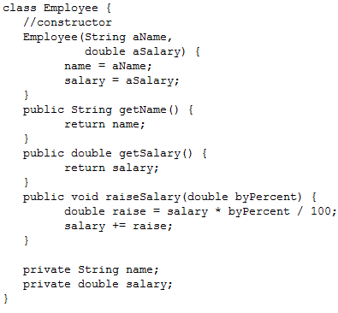
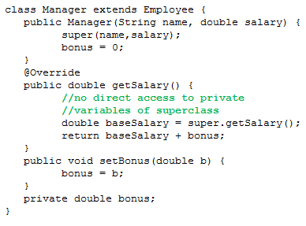
And . . .
As a way to extend the behavior of a particular class

Slide 9
Rules Concerning Inheritance
A subclass constructor must make use of one of the superclass constructors (see Manager class), but does not need the same signature as any of these constructors
A class can have multiple (overloaded) constructors. To call one constructor from another, “this” is used (must be the first line of the constructor). Example: public Employee(String name) { this(name, 0.00);
}
A constructor can call a superclass constructor using “super”. See Manager class (also notice super is used in another way to call a superclass method).
If A is a subclass of class B, when the constructor of A is invoked, there is a specific sequence of steps by which the static/instance variables are initialized and the bodies of the two constructors are executed.
DEMO: package lesson5.lecture.orderofexec

Slide 10
Using the Default Constructor
A subclass may make use of the implicit (default) constructor only if either
the no-argument constructor of the superclass has been explicitly defined, OR
no constructor in the superclass is explicitly defined
In either of these cases, the subclass may make use (possibly implicitly) of the superclass' default constructor.
Example //This is ok
class Employee{
Employee(String name, double salary) {
//…//
}
//explicit coding of default constructor
//since another constructor is present
Employee() {
//…//
}
}
class Manager extends Employee {
//no explicit constructor call here, //so the superclass default
//constructor is used implicitly
}
Example
//This is ok
class Employee{
//…//
}
class Manager extends Employee {
//…//
}

Slide 11
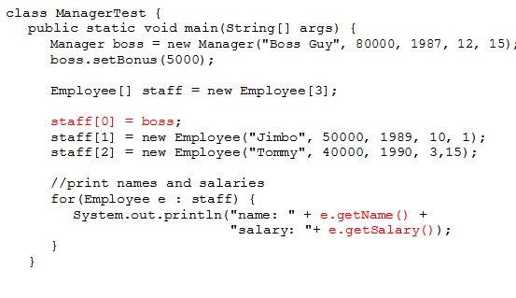
Inheritance  Polymorphism

Slide 12
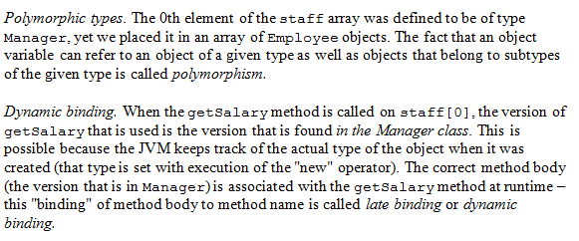
Polymorphism and Late Binding

Slide 13
Main Point 1
When a method is called on a subclass, the JVM by default uses dynamic binding to determine the correct method body to execute. Early binding (and hence a slight improvement in performance) can be forced by declaring a method final.
In a similar way, it is said (Maharishi, Science of Being) that an enlightened individual need not continually plan and prepare in order to meet the needs of his daily life – instead, the enlightened enjoys spontaneous support of nature, and sees what to do as situations arise.
Such individuals are an analogue to "late binding".

Slide 14
Abstract Classes and Methods
When a class is declared to be abstract, it cannot be instantiated directly.
When a method in a class is declared abstract, it means no implementation of the method is provided, and it must be implemented by a subclass.
When a method is declared to be abstract, its enclosing class must also be declared abstract.
Abstract classes may include instance variables and other non-abstract (implemented) methods

Slide 15
Abstract Class Example
public abstract class Product {
private String productId;
public abstract double getPrice();
public String getProductId() {
return productId;
}
public void setProductId(String productId) {
this.productId = productId;
}
}
Stereotype
public class Bicycle extends Product {
@Override
public double getPrice() {
return 230.45;
}
}

Slide 16
Abstract Classes and Polymorphism
When using polymorphism:
Default implementation. Sometimes, a method common to subclasses has a natural default implementation. Example: The getSalary method of Employee.
Abstract method. At other times, a common method has no default implementation and so it is declared abstract – the implementation of the method in this case must be handled by subclasses.
Example: The computeStipend method of StaffPerson

Slide 17
Java Interfaces
A Java interface is like an abstract class execpt:
No instance variables or implemented methods can occur. [Public static final variables can be defined, but not instance variables.]
Can implement more than one interface. [Note: no class can have more than one superclass.] Syntax:
MyClass implements Intface1, Intface2, Intface3
Can also extend and implement. Syntax:
MyClass extends SuperClass implements Intface1, Intface2 Example: In Java, ArrayList implements 6 interfaces and extends one class. (What are they?) Other features:
One interface can extend another. Example: List extends Collection
In many cases, when an abstract class is used for polymorphism, an interface could be used instead.
All methods are automatically public and abstract Demo: See package lesson5.lecture.intfaces2

Slide 18
Interface Example
UML has two different
notations for Interfaces
public interface IProduct {
public abstract double getPrice();
}
Stereotype
Bicycle
<<interface>>
public class Bicycle implements IProduct {
@Override
public double getPrice() {
return 230.45;
}
}
Question: Is there a good reason to use an interface instead of an abstract class?
IProduct
+getPrice()
+getPrice()

Slide 19
Interface Example
UML has two different
notations for Interfaces
public interface IProduct {
public abstract double getPrice();
}
Stereotype
Bicycle
<<interface>>
public class Bicycle implements IProduct {
@Override
public double getPrice() {
return 230.45;
}
}
One benefit: Bicycle extends the
superclass Vehicle and at the same time
implements IProduct as does every product in our system.
IProduct
+getPrice()
+getPrice()

Slide 20
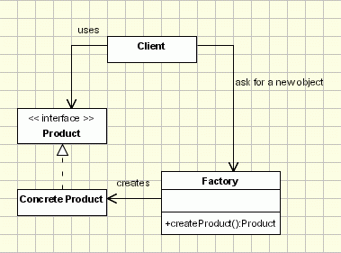
Application of Interfaces: Object Creation-Factory
Demo: lesson5.lecture.factorymethods.ConnectExample

Slide 21
Issues:
Classes without public, protected, or package-level constructors cannot be subclassed
The factory method must be distinguished from other static methods.
Use conventional naming
getInstance [often used to invoke a Singleton]
newInstance [used in Class to obtain an instance from a class]
getType
newType
openConnection [URLConnection example]

Slide 22
Interfaces as Types
Primitives (int, float, etc) are types
Classes provide an ‘interface’ and an implementation
In this context the interface is ‘The publicly exposed methods’
More specifically ‘what you can do with a class of this type’
This ‘interface’ is therefore considered to be the type
A Java Interface provides a pure ‘type’
Just specifies what you can do with an implementer of the interface

Slide 23
Interfaces and Polymorphism
Since interfaces are types just like classes, they can be used in the same polymorphic ways that classes can be used. [Recall that List is an interface in the Java collections library]
As variable type:
List<Student> students = new ArrayList<Student>();
As argument type:
public void createTranscripts(List<Student> students)
As return value type:
public List<Student> findStudents(String country)
See Demos in lesson5.lecture.intfaces1, lesson5.lecture.intfaces2

Slide 24
Multiple Inheritance in Other Languages (like C++)
Diamond Problem
Which (conflicting) implementation do we use?
Note there is no conflict among the types (interfaces) declared by the different classes
Which version of method()
Does D inherit?

Slide 25
Java’s Answer (pre - Java SE 8)
Implementation can only be ‘inherited’ / extended once
Types can be ‘inherited’ / implemented multiple times
No limit on the amount of interfaces you can implement
A single interface can extend multiple other interfaces
Dog ‘is a’:
Animal, Pet, and Companion

Slide 26
Interface vs. Abstract Class: Pre-Java 8
Interface has no implementation
Important types should always be interfaces to allow for ‘multiple’ inheritance
Interface takes abstraction one step further.
Abstract class is an abstraction of its subclasses – provide common implementation.
Interface is an abstraction of its (abstract) subclasses – provides common type.

Slide 27
Some Advantages of Interfaces
They support the safe part of multiple inheritance
They enforce information hiding and encapsulation.
Remember encapsulation is about grouping data and methods together for ease of use. Information hiding hides the implementation from the public ‘interface’.
They support change – implementation can be changed behind the interface
They support development of code in parallel – each team can rely on other teams interfaces even before they are implemented.

Slide 28
Flexibility of Interfaces – In class exercise
Interfaces let you take greater advantage of polymorphism in your designs, which in turn helps you make your software more flexible.
In your small groups modify this class hierarchy so it supports display of images.
[Use an interface to
create greater
abstraction.]

Slide 29
A Solution
With an interface, we can easily add a new class hierarchy
GraphicWindow
<<interface>>
draws
IDrawable
+display()
+draw()
+erase()
+move()
<<abstract>>
Shape
-x
-y
-color
+draw()
+erase()
+move()
Rectangle
Circle
-width
-radius
-height
+draw()
+draw()
+erase()
+erase()
+move()
+move()

Slide 31
Interfaces Support Team Development
First define the interfaces for all subsystems, then every programmer can program one subsystem by using the interfaces of the other subsystems.
The implementation of subsystems may change without affecting all other subsystems, as long as the interfaces remain the same.

Slide 32
Interfaces in System Development
If you have a subsystem that represents an abstraction that may have multiple implementations, whether the subsystem is a single object, a group of objects, an entire Java applet or application, you should define Java interfaces through which the rest of the world communicates with that subsystem.
When you use interfaces in this way, you decouple the parts of your system from each other and generate code that is more flexible: more easily changed, extended, and customized. (encapsulation and abstraction)
Program to Interface (P2I), rather than implementation.

Slide 33
Best Practices: When to Use Interfaces?
Always use interfaces for subsystem development
Prefer interfaces over multiple levels of abstract classes
If an abstract class will provide all the abstraction you need, then do not add an interface.
Code will be read many more hours than it will take to write it. Make it as simple, elegant, and clear as possible.
“as simple as possible, but no simpler” (Einstein)

Slide 34
The Evolving API Problem
Problem: You have created a library of Java classes and you have a substantial clientele who make use of your library. Your library contains numerous interfaces, for which you have implementations (in some cases, multiple implementations) in your library code.
Suppose you now want to add new functionality to your library. In many cases, you will need to add new methods to some of your interfaces. You think “I have to be careful not to change the signature of my interface methods, but adding new methods should not create a problem for my users.” You add some methods, and distribute a new release.
A few days later you get hundreds of complaints that your new code has broken the code of your clients who were using your library. What went wrong?

Slide 35
Explanation:
Clients created their own implementations of your interfaces, in earlier versions of your code. When you add new methods to those interfaces, their code breaks because they do not have implementations of the new methods.
New features of interfaces in Java 8 provide a solution to this and other issues concerning interfaces.

Slide 36
Main Point 2
Abstract classes and Interfaces are both strongly related to the concept of Inheritance.
The interface is the most abstract entity in the class diagram, and by pro-gramming to interfaces, we generate more flexible code.
Greater abstraction holds the possibility of greater potential; this priniciple is especially evident in the case of the unified field.

Slide 37
Summary
Today we looked at modeling Abstractions through Inheritance, Abstract classes and Interfaces. We also looked at the design decisions that go along with using them:
Abstract classes and Interfaces contain less and less implementation details, and instead focuses more on general abstract parts (like types)
With Java it is important to always Program to Interface - P2I.
Use interfaces for ‘multiple’ inheritance, encapsulation, flexibility, and team work.

Slide 38
